Slide 1
CLGE Working for a Profession

Slide 2
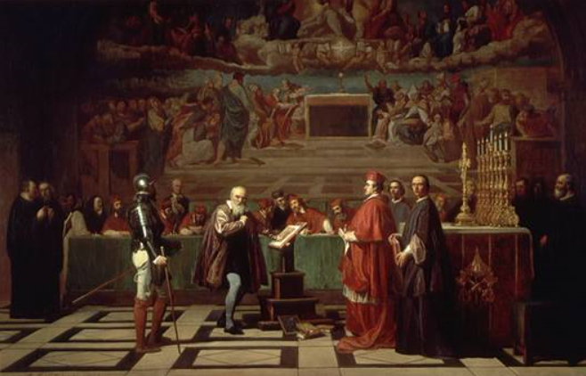
Changing world

Slide 3
Changing world

Slide 4
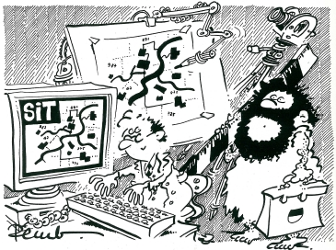
The surveyor yesterday and today
The technology and the society make us evolve
The pressure of technological development is driving social change
Notes:
…now, I would like to take you through some of the issues and developments that we observed and that we think have some relevance to the cadastre:
from drawing board and pencil to computer technology
from terrestrial measurements to photogrammetry and GNSS
from analogue to digital
from paper maps to databases to knowledge bases
technology push vs. citizen pull
trend from written word to imagery
social media
Big Data, Data Mining
geolocalization becomes mainstream
legitimacy often prevails legality

Slide 5
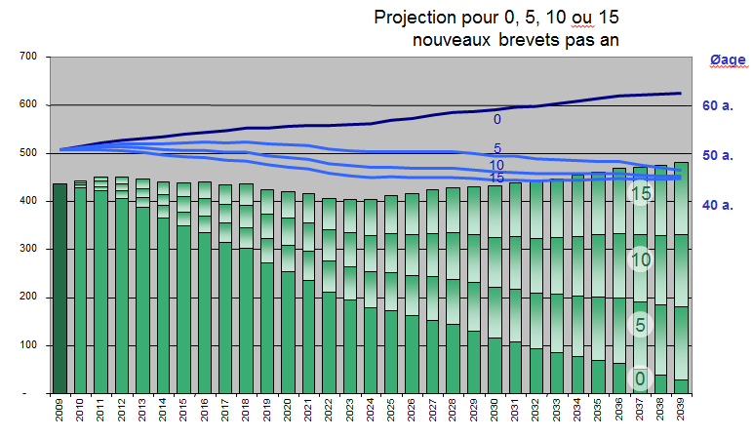
The surveyor tomorrow?

Slide 6
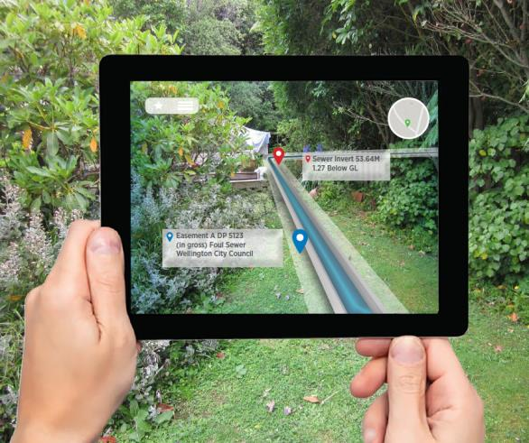
The (r)evolution of cadastre
Augmented reality
Apps will be the basis of all land representations, including those in the cadastre
The parcel as the nucleus of every real representation
Notes:
Developments that potentially have considerable impact on the Cadastre:
satellite imagery on a nearly daily basis;
away from paper-based to object-based data models;
increasing number of updates and acceleration of processing time;
more complete picture of legal situation (→ 3D), not only above ground, but very much also underground;
status of cadastre at different times (→ 4D), in order to produce virtual simulations over time.

Slide 7
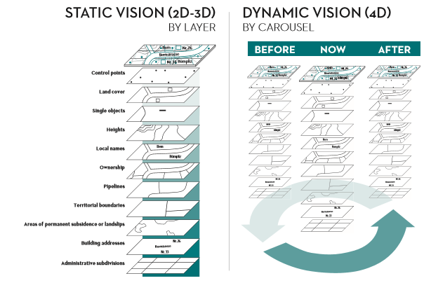
The (r)evolution of cadastre
Vers un changement du contexte légal…
Numerous political decisions depend on official data
Notes:
CH 900 Billions of mortgages

Slide 8
The public-private partnership in cadastre in Switzerland

Slide 9
Basic legal Principles
No ownership without registration (art. 656)
No registration without surveying (art. 950)
No surveying without boundary definition (art. 669)
Title registration system
Title guaranteed by the government

Slide 10
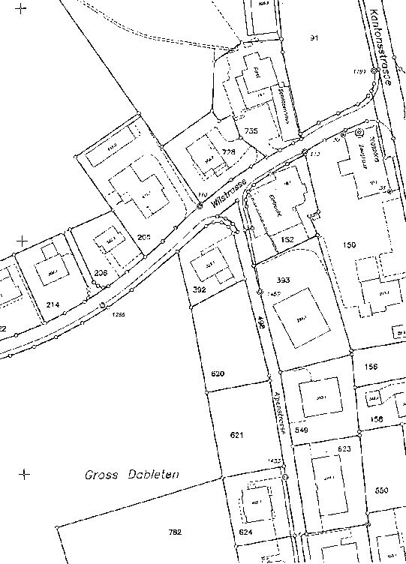
Swiss cadastral system
Cadastral Surveying
Land Register
main book
auxiliary registers (in particular the list of property owners)
deeds (records and evidences)
description of properties
day book

Slide 11
Organisation of cadastral surveying
Level
Organisation
Tasks
Federal Directorate of Cadastral Surveying
Supervision, strategic management
Confederation
approx. 15 employees
Agreements
Canton
Cantonal Surveying Offices
Operational management
Contracts
approx. 300 employees
~270 Private Land Surveying Offices
~15 City Surveying Offices
Municipality
Execution
approx. 3000 employees

Slide 12
Role of Private Sector
Two Partners:
Public Sector
Private Sector
legislation (Federal and cantonal level)
financing structure
setting standards
supervision
co-ordination
verification
production
maintenance
service to clients
innovation
Public Private Partnership

Slide 13
Private Sector – Framework
Surveyors entrusted with cadastral surveying are carrying out a sovereign function and are in this respect regarded as persons of public trust.

Slide 14
Why the Private Sector?
By delegating sovereign duties to the responsibility of the private sector, the federal government can reduce its administrative work load.
The potential for innovation is increased considerably through the inclusion of the private sector
The private industry is located locally = customer proximity
Peripheral regions are provided with quality work places

Slide 15
Tasks of a private surveyor
Initial Survey and Renewal of the cadastral survey
Continuous and periodic updating
Data Processing
Data management
Data delivery
Easement (legal acts)
Certified plans for construction
+ Private mandates
Buildings controls
Monitoring
3D
Consulting
Notes:
Cadastral data belongs to the State

Slide 16
Why License and register?
A license issued to cadastral surveyors and an entry in the register for licensed surveyors guarantee a minimal standard of professional and personal competence in cadastral surveying.
Through the federal register for licensed surveyors, the surveying ordinance makes a clear distinction between an educational certificate, professional practice and disciplinary measures.

Slide 17
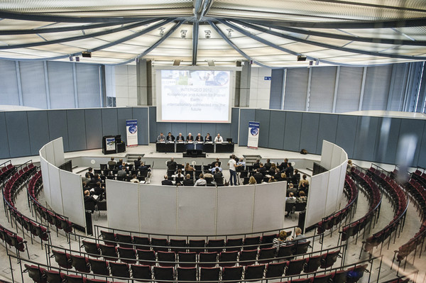
IPMS Coalition
www.eureal.eu
ILMS Coalition

Slide 18
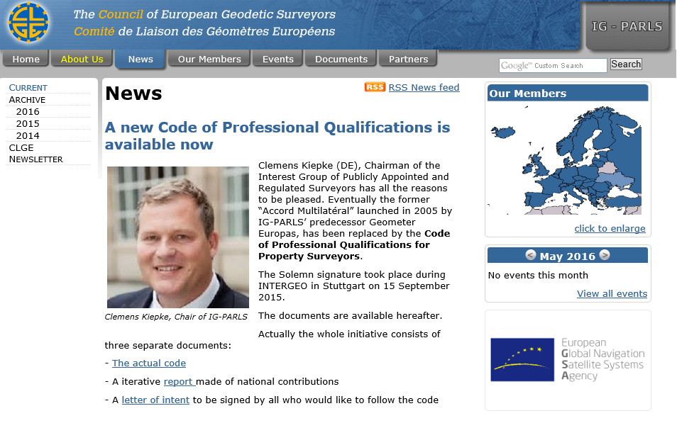
“Code of Professional Qualification for Property Surveyors”

Slide 19
Where are we going?
Crowdsourcing…where are the limits?
Can new technologies like blockchains replace the legal system?
Will the surveyor keep his central role in Property Surveying and Land administration ?
Sustainable fit for purpose cadastral systems have to be implemented through commissions lead by specialists
We have to find our role in the new markets

Slide 20
European Surveyor of the year
Notes:
Here you see the gallery of the first 6 European surveyors of the year, starting in 2012 with Mercator, 2013 Galileo, 2014 Struve, 2015 Euclid, 2016 Rudger Boscovich, and … last but not least General Guillaume Henri Dufour from Switzerland.
In 2013, my predecessor has signed an agreement with our USA Colleagues to work for the creation of the Global Surveyors day.
This is now reality. FIG has accepted this concept and the first Global Surveyors Day will take place on 21 March 2018.
This will be repeated every year the same day, yes from time to time on a Sunday!!!
To celebrate this with the required decorum, CLGE has managed to have a very prestigious venue: next slide

Slide 21
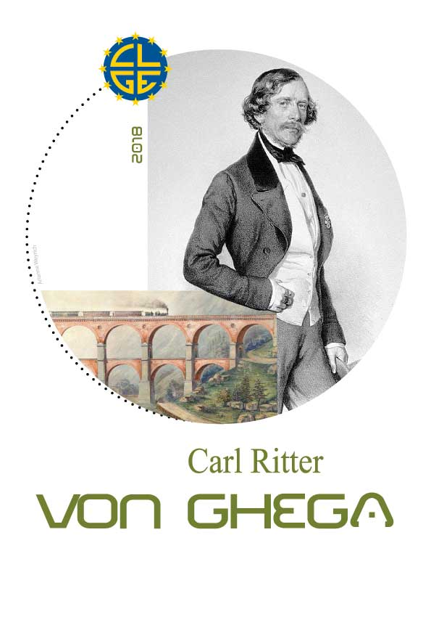
European Surveyor of the year
Notes:
To celebrate this with the required decorum, CLGE has managed to have a very prestigious venue: next slide

Slide 22
Notes:
We invite you all there, to celebrate this and to wave the European Flag together with us.
CLGE will present a paper during this World Bank Land and Poverty Conference, that takes place in this very week.

Slide 23
The First Global Surveyors Day
21 March 2018
Washington D.C.

Slide 24
Thank you for your attention

